Slide 1
Bluebikes
Rider Analysis
Jonas Joehnk
Notes:
Hello!

Slide 2
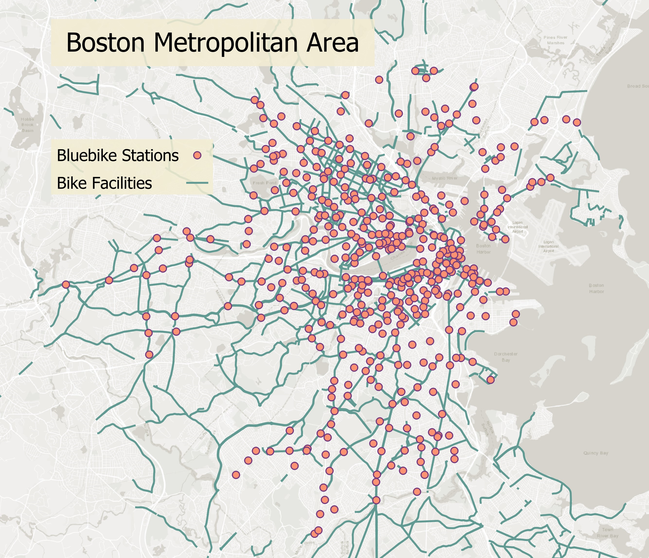
Bluebikes
Boston Metropolitan bike share program that hosts 400 stations and 4000 bikes spanning 11 municipalities
Operated by the City of Boston and neighboring town governments
What can rider patterns of Bluebikes customers from the last 5 years tell us?
Source:: About Bluebikes
Notes:
Introduce Bluebike – government operated bike share program that spans the Boston Metro area
Goal for today is to examine rider utilization levels since 2018 and provide Bluebike with recommendations to increase ridership

Slide 3
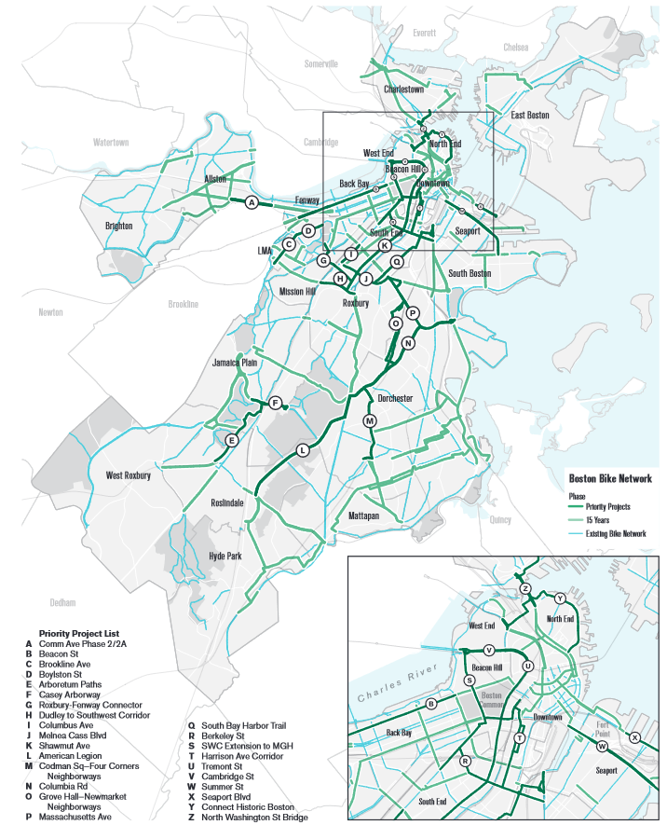
55%
Bicycling in Boston
of Boston residents cite safety as the largest barrier to traveling by bike
Go Boston 2030 transportation initiative released in 2017
Goal to install more accessible and safe bicycle infrastructure by 2030
“Vision Zero” target to eliminate all traffic related deaths
Source: Massachusetts Bay Transportation Authority (2021), Go Boston 2030
Notes:
Context
Boston has made more accessible and safe bicycling a priority
Go Boston 2030 Initiative from 2017 shared lofty goals around transportation, such as building safer and more expansive bike facilities (as seen in the photo)
and making the ambitious “Vision Zero” target to eliminate all traffic related deaths
And Bostonians agree! A 2021 survey of residents found that 55% of individuals surveyed cited safety as the number one reason they don’t bike more – or at all

Slide 4
Driving Questions
1
2
3
Bluebikes User Trends
How have rider utilization levels changed from 2018 to 2023?
Infrastructure Changes
How has the physical landscape changed for bicyclists in Boston?
Is there a correlation?
Has Boston’s continued efforts to provide a more accessible and safe landscape for bicyclists been a success?
Notes:
With this in mind – the driving questions for today are….

Slide 5
The Data
Bluebikes
Bikeshares data from January 2018 to March 2023 of over 13 million rides
Boston MAPC Bike Facilities
Spatial data of 1281 miles of bicycle lanes in the Boston area, with opening years and facility type
Boston Vision Zero Crash Records
Details on 2415 bicycle accidents since 2016
Assumptions and Limitations
Where year data is not known, assumed to be before 2018
Boston population assumed to be static
Limited viable data from the consumer perspective
Bluebikes spans several cities, much of the secondary data focuses on Boston
Pre-During-Post Pandemic eras defined by presence of mandated lockdown measures
Notes:
Three datasets that are foundation to this research:
Bluebikes data from 2018-2023
MAPC Bike Facilities
Boston Crash Records
Assumptions/Limitations
- different degrees of specificity of time (bike lane or station built in 2019 could have been in December, while crash data happened back in Jan)
- at this stage of research, Boston residents and bicyclists are a static figure
- Pre-During-Post Covid eras defined by presence of mandated lockdown and social distancing measures

Slide 6
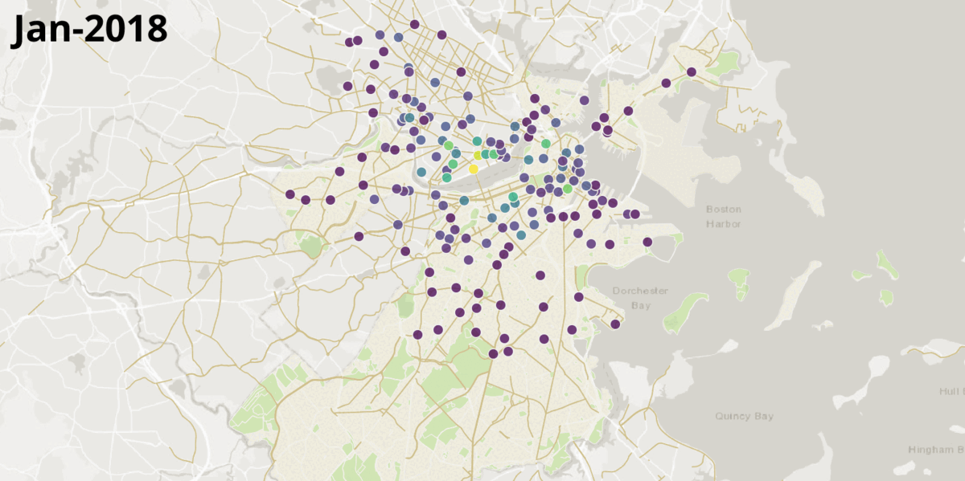
Rider Activity Increasing Year-over-Year
113% growth from 1.7 million annual rides in 2018 to 3.7 million in 2022
190 new bike stations built
1
250
500
750
1000
1250
Rides per Month by Starting Station
Source: Bluebikes System Data
Notes:
Looking at visual impression of number of rides and growth of states month by month
Where dots represent the starting station
Purple indicates around 1-100 riders a month
Yellow indicates upwards of 1300 (some outlier stations by 2022 hitting levels of 10-15k a month!)
Key take-aways:
Bluebikes has seen a 113% increase in ridership from 2018-2022
They have built 190 stations in that period

Slide 7
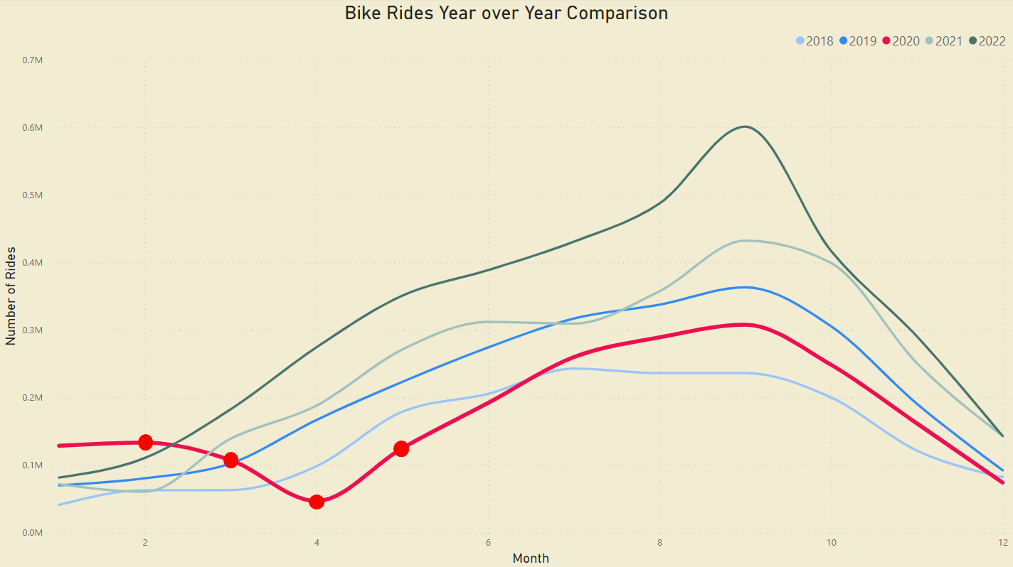
How has the Pandemic impacted Bluebikes?
Healthy Streets Program
State of Emergency Declared
First Case
Stay-at-Home Policies Introduced
Source: Bluebikes System Data, ,Boston Healthy Streets Program
Notes:
Let’s look what happened during the Pandemic and how it impacted ridership
Steep drop at the start of the year, but quickly rebounded by late spring and ridership soaring ever since
Key events highlighted:
-- First covid-19 case in Boston February of 2020
-- State of Emergency declared in March (where rider activity plummets)
-- The first stage of stay-at-home policies introduced in April (work from home, only essential businesses opened, social distancing)
But bluebikes riders then head out and surpass 2018 levels by July
-- For the next stage of my research, I want to look at how their Healthy Streets program could have had an influence
This was an initiative to tackle many of their Go Boston 2030 plans at an expedited rate
-- Protected bicycle lanes
-- Larger lanes to encourage social distancing of pedestrians and bicyclists

Slide 8
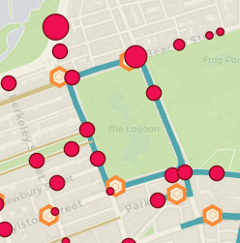
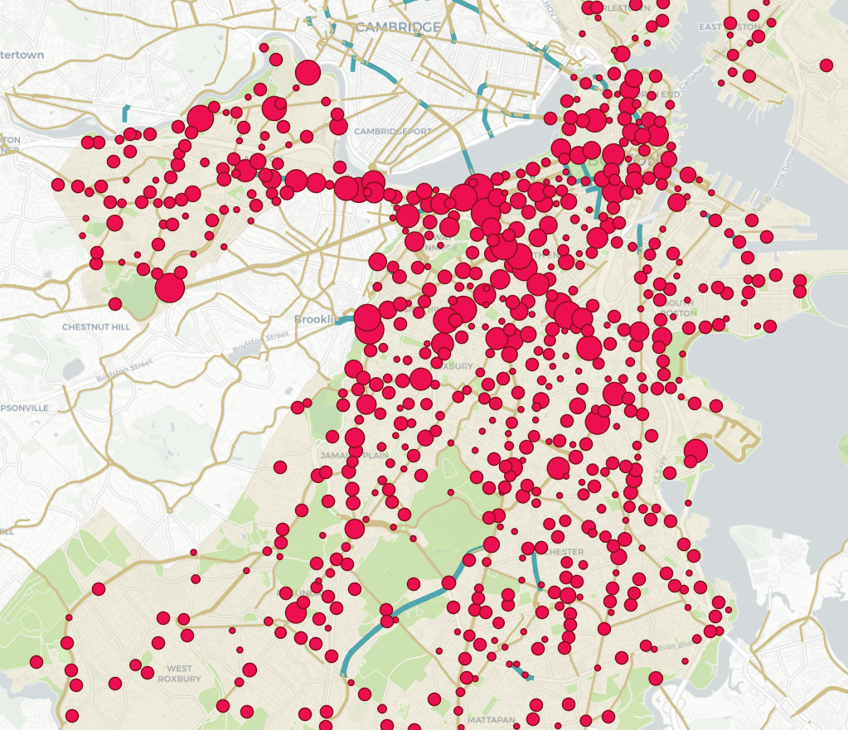
Bike Safety and Facilities at Boston Common
Case study of Boston Common Public Garden, where Separated Bike Lanes were constructed in 2021
Examining 5 stations’ utilization levels and number of crash levels since 2018
Source:,Boston Healthy Streets Program , Streetsblog Mass
Notes:
Goal of research:
- Identify where fatal bicyclist crashes happen in relation to bicycle lanes, and if on a bicycle lane, what is the quality? A shared street or a barrier protected lane?
- See trends year over year since 2018
For now, I will be showing two localized cases as examples of this broader work
Starting with the Separated Bike Lanes constructed around the Boston Common Public Gardens in 2021 – how was rider utilization compared to the number of crashes, especially before and after the lane improvement?
- The map shows crashes in red, Bluebike stations in orange, and improved bike lanes in teal

Slide 9
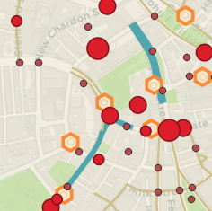
Bike Safety and Facilities at Cambridge St
Case study of Cambridge St where a Buffered Bike Lane was constructed in 2021
Examining 4 stations’ utilization levels and number of crash levels since 2018
Source:,Boston Healthy Streets Program , Streetsblog Mass
Notes:
And just north of the Public Gardens, I’ll be looking at the Buffered Bike Lane introduced on the southern tip of Cambridge St in 2021 and the four stations surrounding it

Slide 10
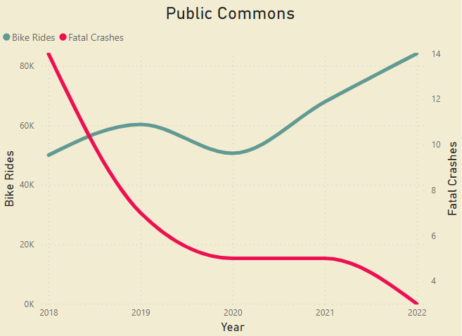
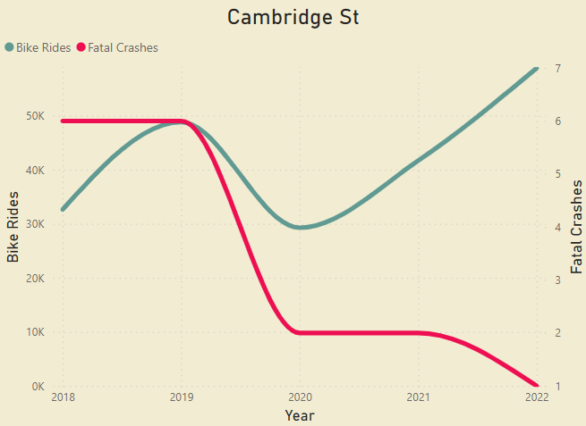
Bike Activity Correlations
Bike Facility
Bike Facility
Stay-at-Home Policies
Stay-at-Home Policies
Initial case studies indicate impact of COVID-19 (remote work policies and less vehicle traffic), as well as improved bike lanes for these two street segments.
Source: Bluebikes System Data, , MAPC Facility Lines , Vision Zero Crashes ,
Notes:
Here is what I found!
While this cannot be confidently generalized for all of Boston and the surrounding cities, but they offer some great indications of what to look at next
Both areas saw crashes roughly HALF at the start of the pandemic (which is where the next portion of this research will include the additional variable of car ridership levels over time)
Both also show further increases in activity and drop in crash numbers
However, to emphasize again, this is only two very small hand selected areas!

Slide 11
What can Bluebikes do to continue their success?
Soaring bike share rider levels, coupled with massive improvements in bicycle infrastructure and safety point to a more bike-friendly Boston
Insights from new remote-work era where fewer cars are on the road – how can we continue this as Bostonians return to the office?
Notes:
But what can we learn from these initial insights?
What do these rider trends tell us and how do they direct any proposed recommendations?
One – CONGRATS to Bluebikes who have seen resounding success over the past year, with utilization levels doubling post covid as compared to pre-covid. And the impact during COVID was minimal and not lasting.
We can see clear correlations between rider levels, bike facility improvements and a reduction in fatal crashes, showing that their Go Boston 2030 initiative seems to be a successful step in a positive direction.

Slide 12
Next Steps
Additional research needed to offer better recommendation
Relationship between bicycle crashes, facilities, and activity levels
Utilization trends of other transportation methods
Differences in usage for customers and subscribers, or more broadly between bike share users and other bicyclists
Notes:
How can we be more confident in these relationships?
Here are my plans for further research to study the success Bluebikes has seen from 2018 to 2023.
-- Spatial data analysis described previously to compare locations of crashes, presence and/or quality of bike facilities, and trends in ridership
-- Introducing trends of other transportation methods in this time period
-- Looking more specifically at our bicyclists!
- Beyond the scope of this project, a sentiment analysis of how Bostonians feel about bike riding would offer crucial insight
- Looking at the different activity patterns for customers and subscribers may offer additional insights

Slide 13

Thanks!
Do you have any questions?
Art credited to: Gwen Vanderstraeten
Notes:
And with that, thank you all very much.
Are there any questions?

Slide 14
REFERENCES
Guide to riding a bike share
https://www.hcaog.net/sites/default/files/8c_guide_to_running_a_bike_share.pdf
COVID-19 State of Emergency
https://www.mass.gov/info-details/covid-19-state-of-emergency
Boston COVID-19 Dashboard
https://bphc-dashboard.shinyapps.io/BPHC-dashboard/
SARS-CoV-2 Variant Proportions from CDC
https://data.cdc.gov/Laboratory-Surveillance/SARS-CoV-2-Variant-Proportions/jr58-6ysp
One Year Later: Timeline of COVID-19 Pandemic in Massachusetts
https://www.cbsnews.com/boston/news/coronavirus-massachusetts-timeline-pandemic-one-year-later/
Bicycle Facilities (Lines) in Boston
https://datacommon.mapc.org/browser/datasets/356
Boston Existing Bike Network Data Dictionary
https://data.boston.gov/dataset/existing-bike-network-2023/resource/3f93c2cc-85c0-4521-88c2-815cbc33e33b
Boston Street Segments
https://data.boston.gov/dataset/boston-street-segments
Go Boston 2030 Full Report
https://www.boston.gov/sites/default/files/file/document_files/2019/06/go_boston_2030_-_full_report.pdf
Boston’s biking has improved but still has a ways to go
https://www.sierraclub.org/massachusetts/blog/2022/09/boston-s-biking-has-improved-still-has-ways-go
Vision Zero Crash Records
https://data.boston.gov/dataset/vision-zero-crash-records
Boston Statewide Bike Survey 2021
https://www.massdottracker.com/datablog/?p=1479
Boston Planning Additional Crosswalk, Bike Lane Upgrades Around Public Garden
https://mass.streetsblog.org/2021/12/14/boston-planning-additional-crosswalk-bike-lane-upgrades-around-public-garden
Protected Bike Lanes on Cambridge Street Could Be Part of MGH Project
https://mass.streetsblog.org/2021/05/19/protected-bike-lanes-on-cambridge-street-could-be-part-of-mgh-hospital-project
Boston Neighborhood Bike Projects
https://www.boston.gov/departments/boston-bikes/neighborhood-bike-projects

